Slide 1


Web scraping to gain company insights

Slide 2
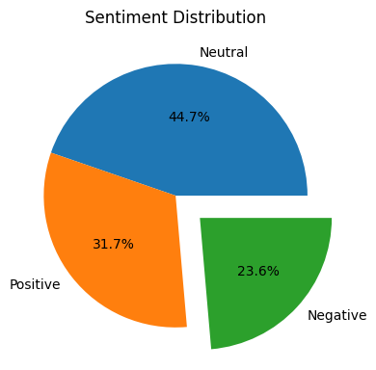
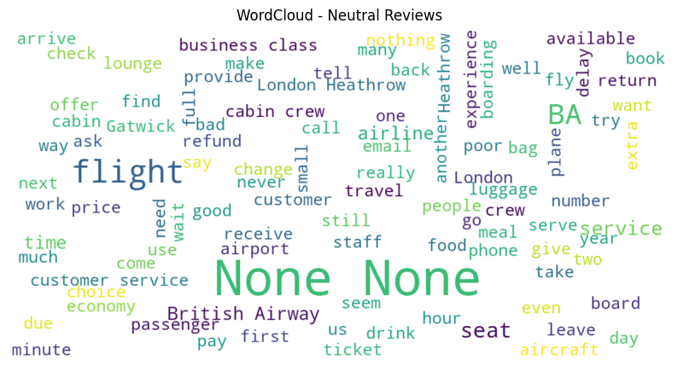
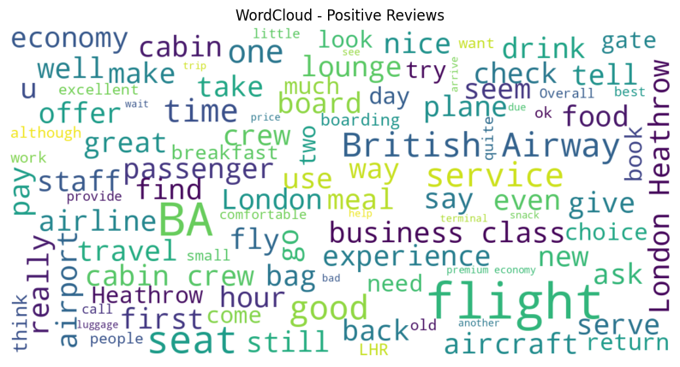
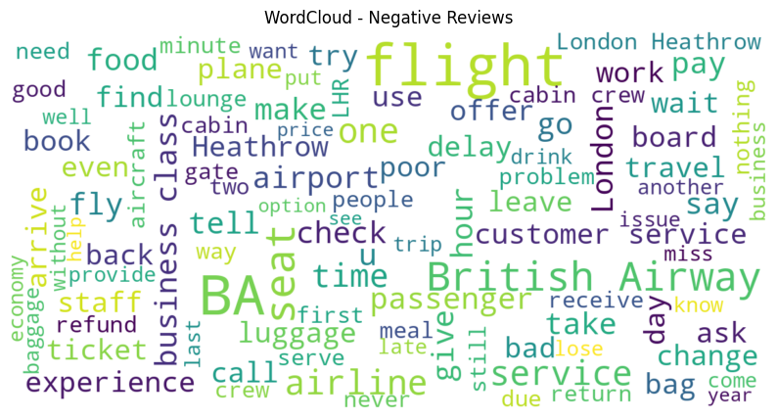
INSIGHTS FROM CUSTOMER REVIEWS
From cleaning 3800 reviews given by the customers, we obtained
Neutral Reviews - 1699
Positive Reviews - 1203
Negative Reviews – 898
Word cloud of keywords used in reviews

